Slide 1
Adaptive monitoring for early-stage ransomware detection in Network Traffic Analysis
Presented By
YERRAPPAGARI HEMA SREE (22BFA37070)
GURRAMKONDA UMAR SHAROOK (22BFA37046)
MADDILETI HARI PRASAD (22BFA37059) NARA MANOJ KUMAR (22BFA37065)
Under the guidance of
Mr. K Nagendra Rao, Assistant Professor, Dept of CSC
Department of Computer Science And Engineering(Cyber Security) S V COLLEGE OF ENGINEERING
(Autonomous)
Karakambadi Road, Opp. LIC Training Center Tirupati-517507

Slide 2
CONTENTS
Abstract
Introduction
Existing System
Proposed System
Modules Description
UML Diagrams
Software and Hardware requirements
Project Implementation
Testing
Results
Future Enhancements
Conclusions
References

Slide 3
ABSTRACT
The growing threat of ransomware highlights the need for advanced early detection systems. Traditional signature-based methods often fail to identify new or evolving ransomware strains, emphasizing the importance of adaptive and proactive monitoring. This project presents a framework for early-stage ransomware detection using behavioral and network traffic analysis. The proposed system employs machine learning algorithm to monitor file access patterns, encryption activities, and unauthorized data movements, alongside abnormal network behaviors such as unusual data transfers or encrypted communications. This system uses random forest for classification and regression. By continuously learning from new data, the adaptive model evolves to recognize emerging ransomware tactics while reducing false positives. The multi-layered design enables comprehensive real-time monitoring and early alerts, allowing quick response actions such as system isolation to prevent spread and minimize damage. Experimental results confirm the framework’s effectiveness in detecting ransomware in its initial stages, enhancing organizational resilience and contributing to intelligent cybersecurity solutions that integrate behavioral and network analysis for stronger protection against sophisticated threats.
Keywords: Ransomware Detection, Adaptive Monitoring, Network Traffic Analysis, Early-Stage Detection, Random Forest, Cybersecurity, Real-Time Monitoring, Malware Prevention

Slide 4
INTRODUCTON
Machine learning–based ransomware detection identifies and prevents ransomware attacks by analyzing system behavior and network traffic.
The system uses algorithms like Random Forest and Logistic Regression to detect suspicious patterns and anomalies.
It monitors unusual file access, encryption activity, and abnormal network communication.
The framework allows users to analyze data, train models, and predict threats through a simple interface.
This approach enables early detection of ransomware, protecting systems and reducing data loss.

Slide 5
EXISTING SYSTEM
Traditional ransomware detection systems mainly rely on signature-based methods, which cannot detect new or unknown ransomware variants.
Many existing systems fail to identify early indicators of ransomware, such as abnormal file access patterns and encryption activities.
Most approaches focus only on single detection techniques like file behavior or network monitoring, lacking integrated analysis.
Static detection models cannot adapt to evolving ransomware attacks, making them ineffective against new threats.
Delayed detection often leads to data encryption, system damage, and financial loss for organizations.
Limited real-time monitoring capabilities reduce the ability to prevent ransomware before it spreads across the network.

Slide 6
PROPOSED SYSTEM
The proposed system uses adaptive monitoring to detect ransomware at an early stage by analyzing both system behavior and network traffic patterns.
It applies machine learning algorithms such as Random Forest, Logistic Regression, Gradient Boosting, KNN, Naive Bayes, and SVM to identify suspicious activities and anomalies.
The system monitors file access patterns, encryption activities, and unauthorized data transfers, which are common indicators of ransomware behavior.
It also analyzes network traffic anomalies like abnormal connections and large data transfers.
The system provides real-time detection, early alerts, improved accuracy, and helps prevent ransomware attacks.

Slide 7
MODULE DESCRIPTION
Project Modules
User Interface Module
Data Preprocessing
Model Management
Ransomware Detection & Prediction
Data Storage
Security Module
System Administration

Slide 8
MODULE DESCRIPTION
User Interface Module
A simple web-based interface is developed using Streamlit for easy interaction with the system.
Users can upload datasets, select machine learning models, and run ransomware detection through the interface .
The interface displays model accuracy, prediction results, and alerts in a clear and user-friendly way.

Slide 9
MODULE DESCRIPTION
Data Preprocessing
The collected network traffic and system behavior data were cleaned by removing duplicate records, handling missing values, and correcting inconsistent entries to improve data quality.
Categorical features such as protocol type, service, and connection state were encoded into numerical format so they could be used by machine learning algorithms.
Data normalization and feature scaling were applied to ensure consistency across attributes like bytes transferred, packets, and connection duration.
Feature selection techniques were used to retain only the most relevant attributes that contribute to accurate ransomware detection.

Slide 10
MODULE DESCRIPTION
Model Management
The system trains multiple machine learning models using historical network traffic data to learn patterns of normal and malicious behavior.
It uses different algorithms like Random Forest, Gradient Boosting, and Logistic Regression to improve accuracy and reduce errors.
The models are evaluated based on performance metrics such as accuracy to ensure reliable predictions.

Slide 11
MODULE DESCRIPTION
Ransomware Detection & Prediction
The trained machine learning models analyze system behavior and network traffic data to identify suspicious activities.
The system compares new input data with learned patterns to detect possible ransomware attacks.
Based on the analysis, the model predicts whether the activity is normal or ransomware-related.

Slide 12
MODULE DESCRIPTION
Data Storage
The system securely stores uploaded datasets and prediction results for later use.
It maintains logs of analyses and results, allowing users to review past records.
It organizes data efficiently to ensure easy storage, management, and retrieval of information.

Slide 13
MODULE DESCRIPTION
Security module
The system uses machine learning and anomaly detection to analyze network traffic and identify ransomware or suspicious activities.
It applies multi-layer security techniques, including data preprocessing, feature extraction, and multiple models, to improve detection accuracy and reduce false positives.
Role-based access control ensures only authorized users can access data, perform analysis, and view results.

Slide 14
MODULE DESCRIPTION
System Administration
Administrators can manage users by viewing, updating, deactivating accounts, and blocking suspicious users from accessing the system.
The system monitors activities, including usage patterns and detection results, to maintain oversight and security.
It maintains logs and audits of events like failed logins and file transactions, while also supporting secure backups and recovery in case of system failures.

Slide 15
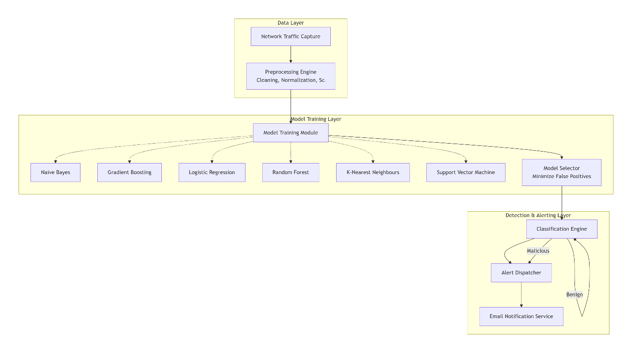
ARCHITECTURE

Slide 16
UML DIAGRAMS
UML represents Unified Modelling Language.
UML diagram is a way to visualize systems and software using Unified Modelling Language (UML).
It is a standardized modelling language used in software engineering to visualize, specify, construct, and document the artifacts of software systems.
Some of those are:-
Class Diagram
Use Case Diagram
Sequence Diagram
Activity Diagram
Component Diagram
Deployment Diagram

Slide 17
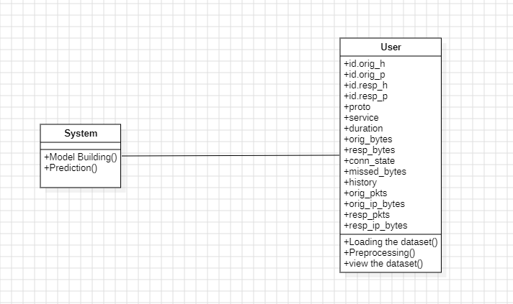
CLASS DIAGRAM
It describes the structure of a system by showing the system's classes, their attributes, operations (or methods), and the relationships among the classes.

Slide 18
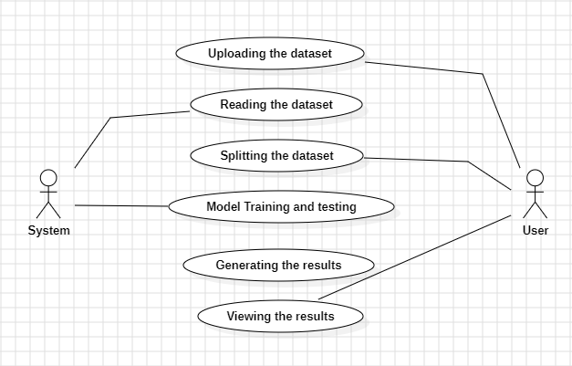
USE CASE DIAGRAM
The main purpose of a Use Case diagram is to show the functionalities of User and System in terms of actors. It Presents the Graphical overview of the user and system functions in terms of actors.

Slide 19
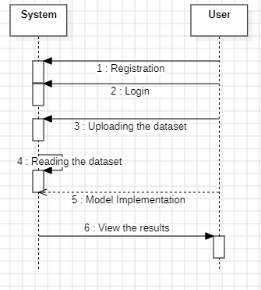
SEQUENCE DIAGRAM
Sequence diagram shows how processes operate with one another and in what order. It is a construct of a Message Sequence Chart.

Slide 20
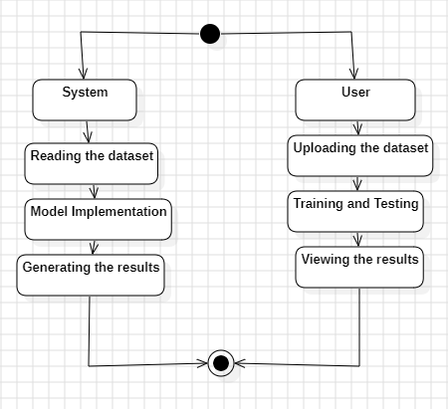
ACTIVITY DIAGRAM
Activity diagrams are graphical representations of workflows of stepwise activities and actions with support for choice, iteration and concurrency.
An activity diagram shows the overall flow of control.

Slide 21

COMPONENT DIAGRAM
A Component Diagram represents the components of a system.
Components – System and User
Package – Datasets

Slide 22

DEPLOYMENT DIAGRAM
Deployment diagram represents the deployment view of a system.
A deployment diagram consists of nodes. Nodes are nothing but physical hardware’s used to deploy the application.

Slide 23
SYSTEM REQUIREMENTS
H/W REQUIREMENTS:
Processor - I3/Intel Processor
Hard Disk - 160GB
Key Board - Standard Windows Keyboard
Mouse - Two or Three Button Mouse
Monitor - SVGA(Super Video Graphics Array)
RAM - 8GB
S/W REQUIREMENTS:
Operating System - Windows 7/8/10
Client-side Script - HTML, CSS, Bootstrap & JS
Programming Language - Python
Libraries - Flask, Pandas, Mysql.connector, Os, Scikit-Learn, Numpy IDE/Workbench - PyCharm
Technology - Python 3.6+
Server Deployment - Xampp Server

Slide 24
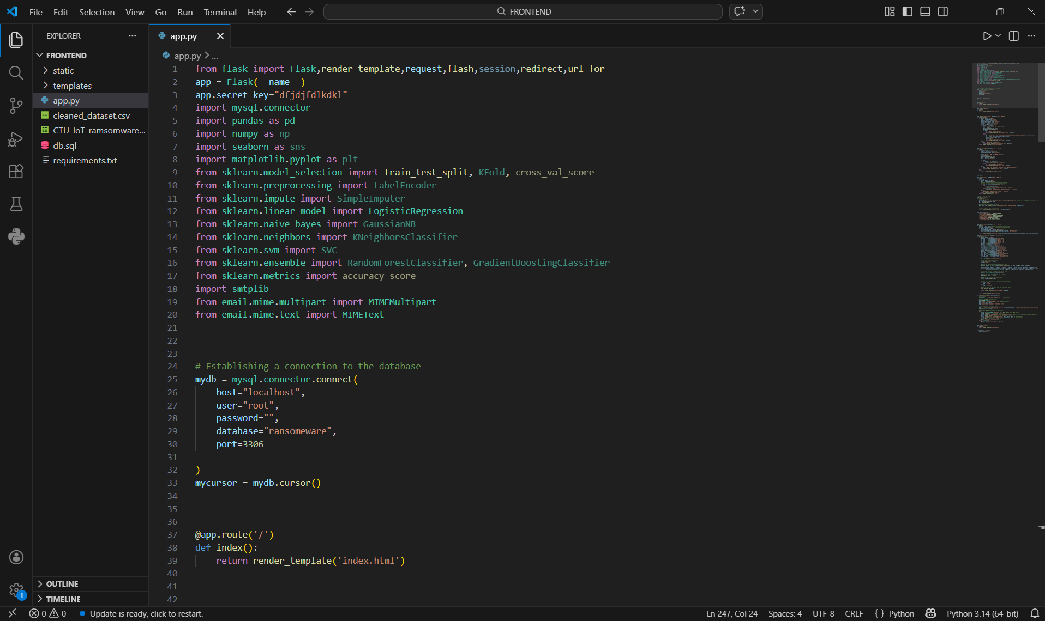
PROJECT IMPLEMENTATION

Slide 25
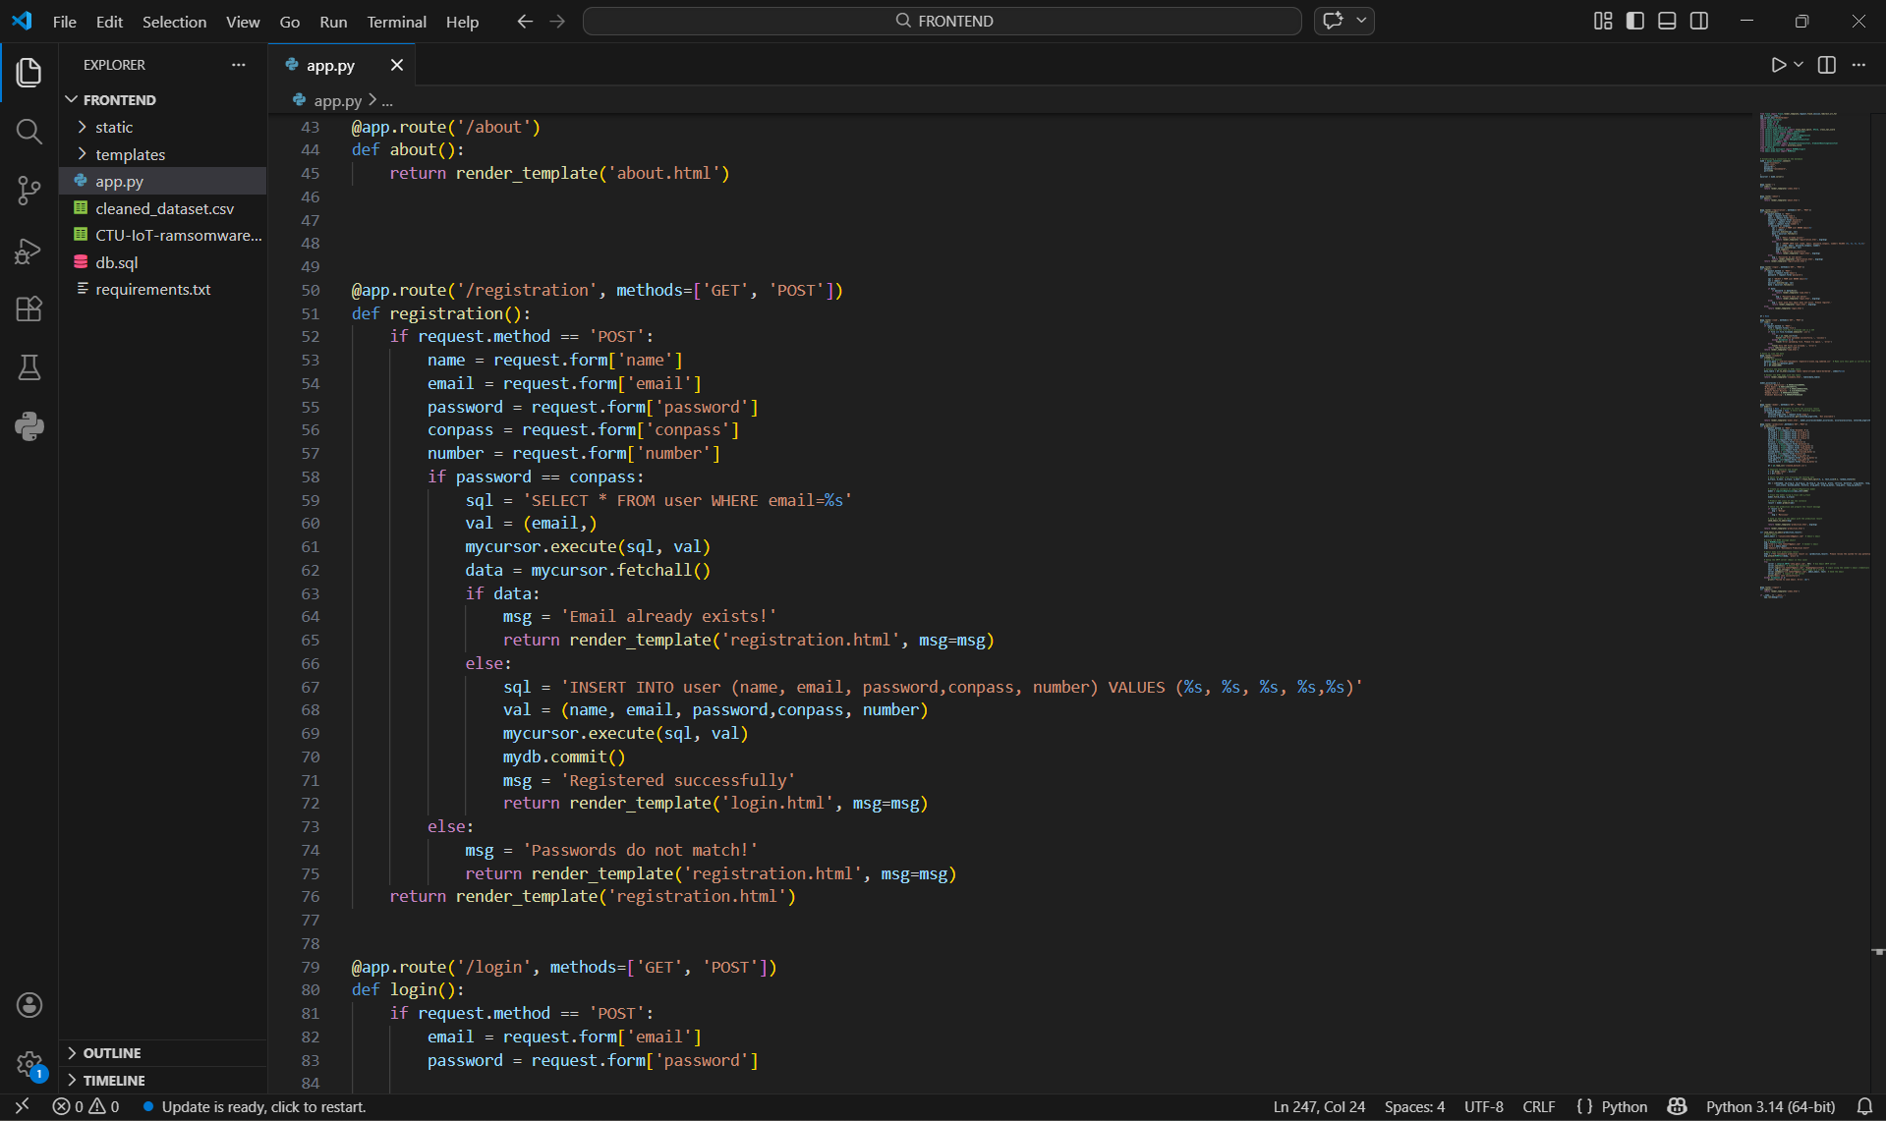
PROJECT IMPLEMENTATION

Slide 26
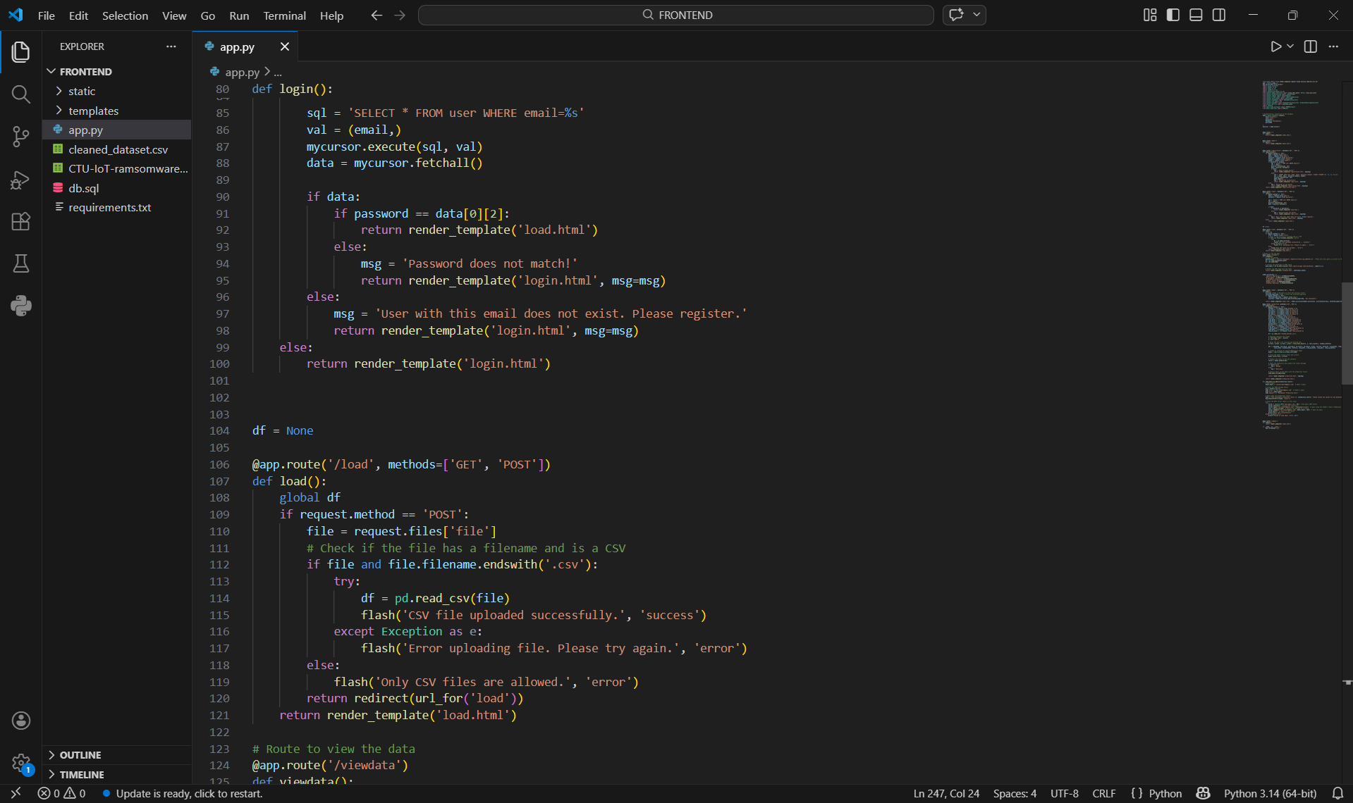
PROJECT IMPLEMENTATION

Slide 28
TESTING
UNIT Testing
Objective: To verify that each individual module of the ransomware detection system functions correctly and produces accurate outputs for given inputs.
Method: Test individual modules under different simulated input conditions to verify correct functionality and measure response time for each unit.
Procedure:
Identify individual modules such as data preprocessing, model prediction, and result generation, and test them separately.
Provide valid and invalid input data to check whether the module produces expected outputs and handles errors correctly.
Verify all decision paths and internal logic to ensure complete coverage and correct functionality of each unit.

Slide 29
TESTING
Integration Testing
Objective: To verify that different modules of the ransomware detection system work together correctly and ensure smooth data flow between components without errors.
Method: Run the system under different simulated activity levels to ensure smooth interaction between integrated modules.
Procedure:
Integrate modules such as data preprocessing, model prediction, and result display, and test their combined functionality.
Provide input data and verify that it flows correctly between modules and produces the expected output.
Identify and resolve any interface errors, data mismatches, or communication issues between components.

Slide 30
TESTING
Acceptance Testing
Objective: To ensure that the ransomware detection system meets user requirements and performs effectively in real-world scenarios.
Method: Test the system with real user inputs and simulated network conditions to verify usability, functionality, and response time.
Procedure:
Allow end users to interact with the system using real or sample network data.
Verify that all functionalities such as data upload, detection, and result display work as expected.
Collect user feedback to ensure the system meets requirements and is user-friendly.

Slide 31
TESTING
Functional Testing
Objective: To verify that all functions of the ransomware detection system operate according to specified requirements and produce correct outputs.
Method: Test the system by providing valid and invalid inputs to evaluate functionality, system response, and output accuracy.
Procedure:
Provide valid network data inputs and ensure the system correctly processes and classifies them as benign or malicious.
Provide invalid or incomplete inputs and verify that the system properly rejects them with appropriate error messages.
Test all system functions such as data upload, preprocessing, detection, and result display to ensure correct execution and output generation.

Slide 32
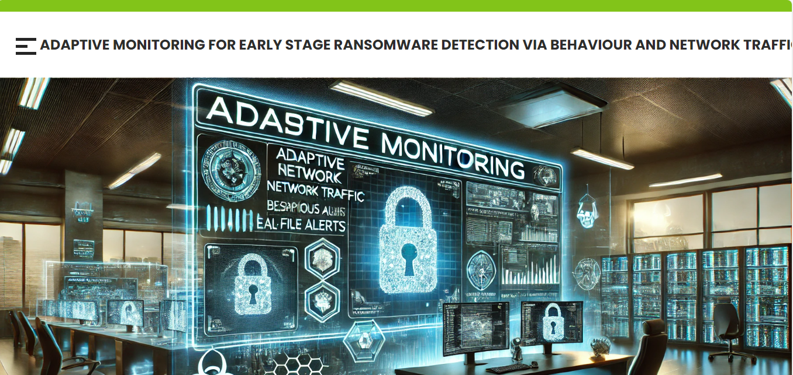
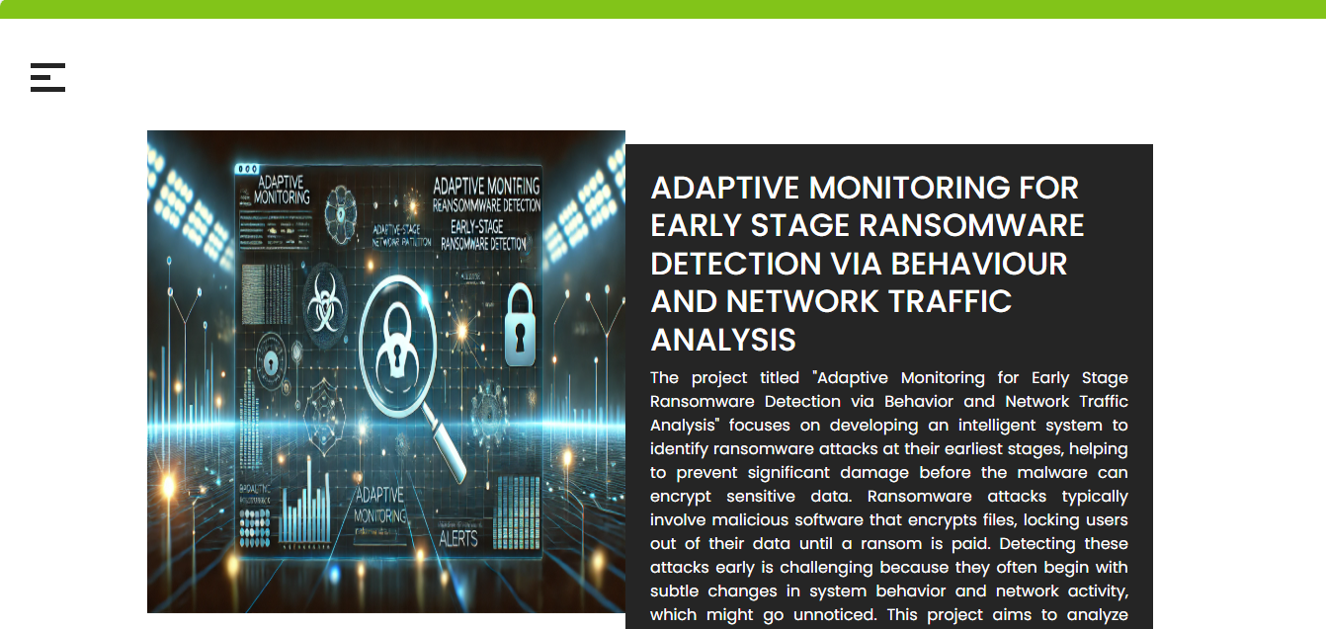
RESULTS

Slide 33
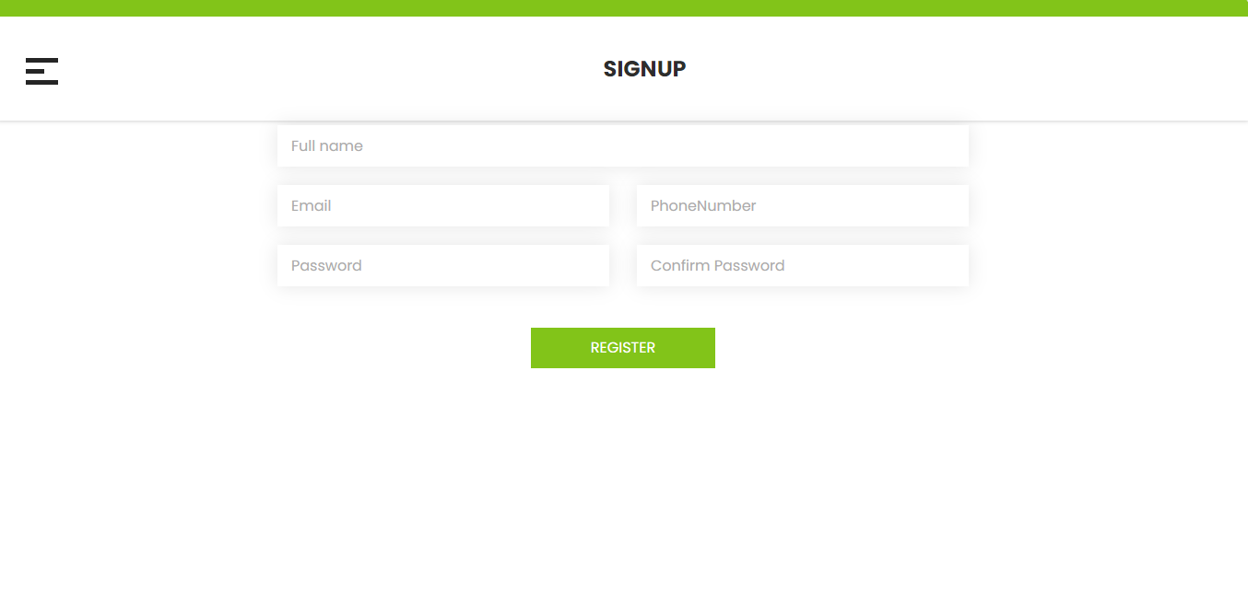

RESULTS

Slide 34

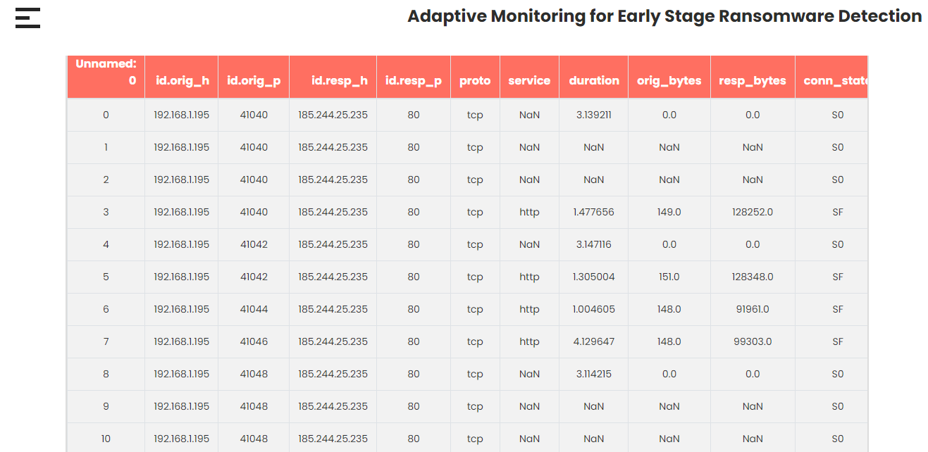
RESULTS

Slide 35
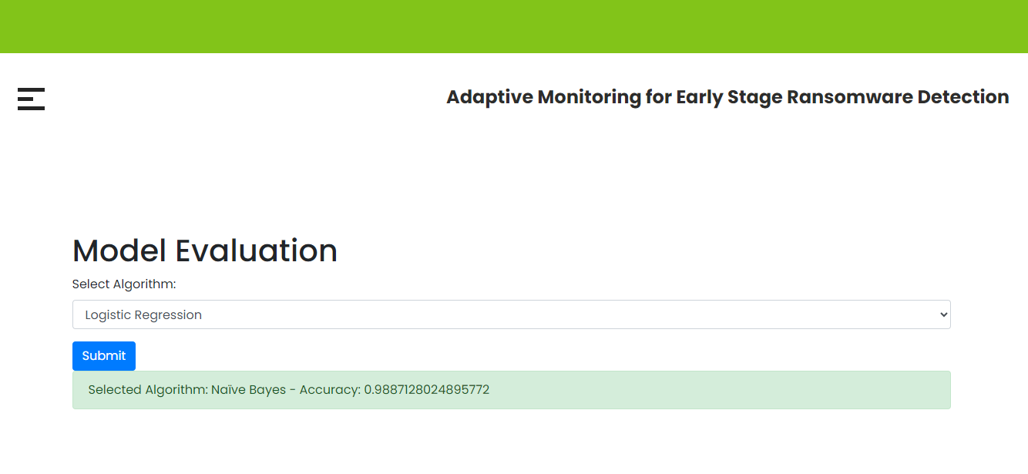
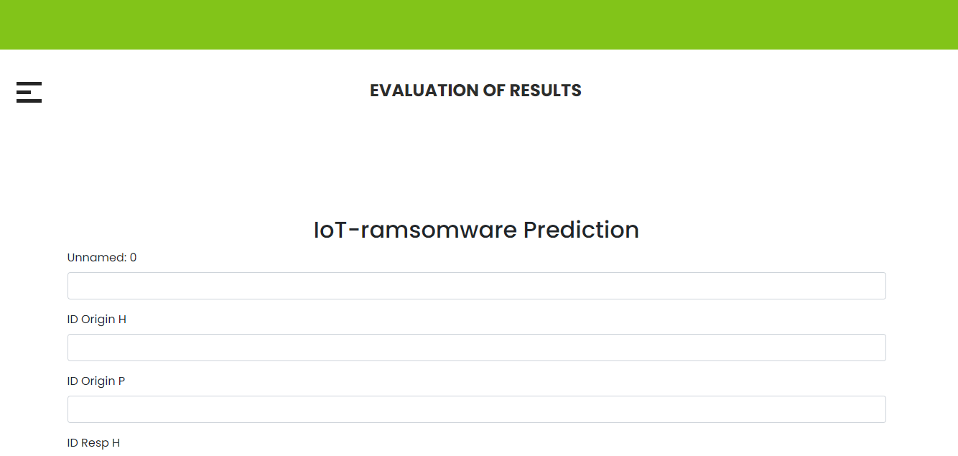
Results

Slide 36
FUTURE ENHANCEMENTS
Integration with Deep Learning:Use deep learning models to improve ransomware detection accuracy and identify complex attack patterns.
Cloud-Based Monitoring: Deploy the system on cloud platforms to monitor large-scale networks and distributed environments..
Threat Intelligence Integration: Connect with external threat intelligence feeds to detect new ransomware variants quickly.
Automated System Isolation: Automatically isolate infected systems to prevent ransomware from spreading across the network.
Continuous Model Updates: Regularly update models with new data to adapt to evolving ransomware threats.

Slide 37
CONCLUSIONS
Adaptive monitoring and machine learning significantly improve early-stage ransomware detection by analyzing system behavior and network traffic patterns. The proposed framework overcomes the limitations of traditional signature-based methods by identifying anomalies such as unusual file access, encryption activities, and abnormal data transfers. This approach enables faster detection, reduces false positives, and supports proactive responses to potential threats. By integrating intelligent models with real-time monitoring, the system enhances cybersecurity, helping organizations protect critical data and maintain secure, reliable digital infrastructures.

Slide 38
REFERENCES
[1] W. Gong, Y. Zha, and J. Tang, “Ransomware detection and classification using generative adversarial networks with dynamic weight adaptation,” 2024.
[2] W. Koyirar, B. Harris, J. Williams, A. Moreno, and E. Davis, “Efficient ransomware detection through process memory analysis in operating systems,” 2024.
[3] J. Axali, L. Devereaux, A. Spencer, and F. Vasilev, “A multicriteria decision-making approach for ransomware detection using mitre att&ck mitigation strategy,” 2024.
[4] H. Kowalczyk, P. Zieli’nski, and A. Nowak, “Dissecting macos ransomware: A comparative analysis and mitigation strategies,” 2024.
[5] Y. Brinkley, D. Thompson, and N. Simmons, “Machine learning-based intrusion detection for zero-day ransomware in unseen data,” 2024.

Slide 39
Thank You

